Slide 1
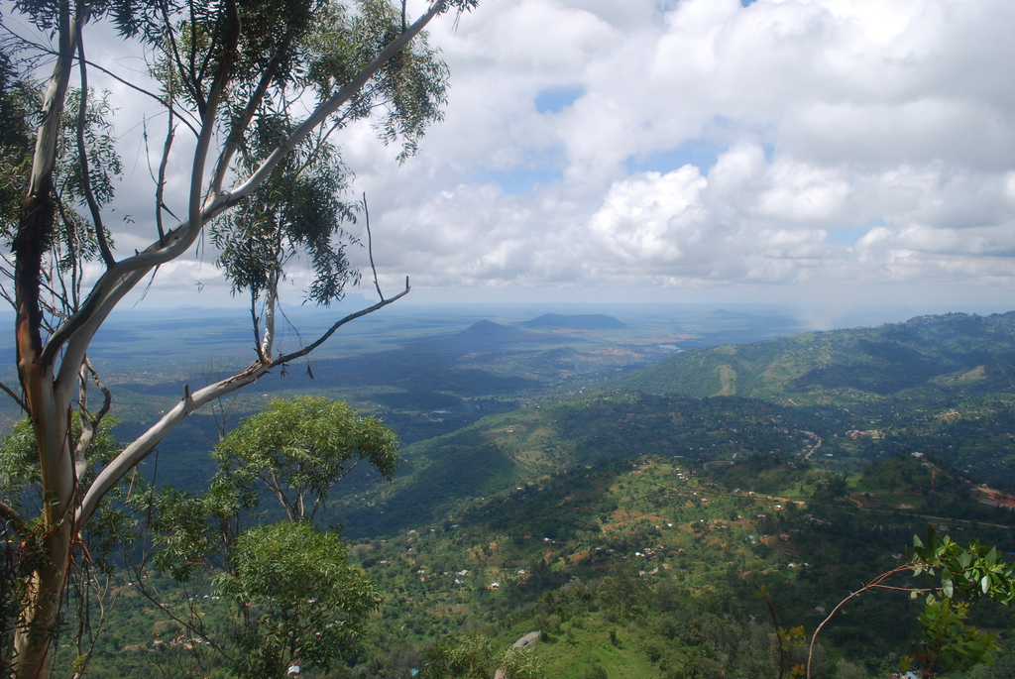
African species’ response to
land-use change
Recommendations for broad-scale diversity models from an independent study
Notes:
Blackend first

Slide 2
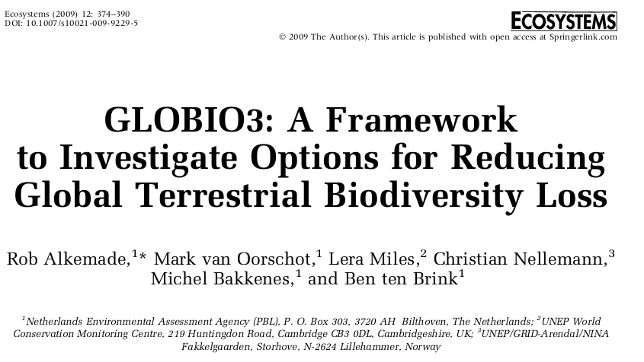
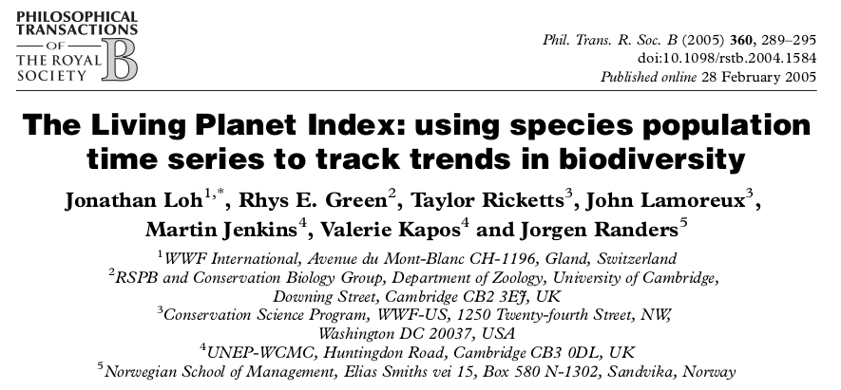
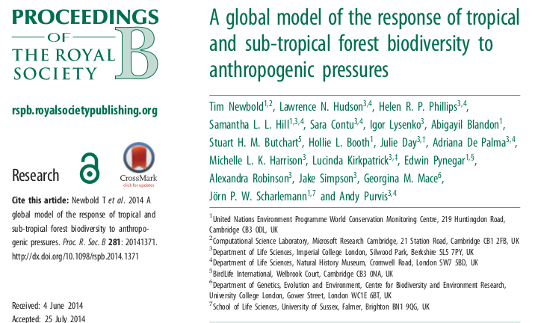
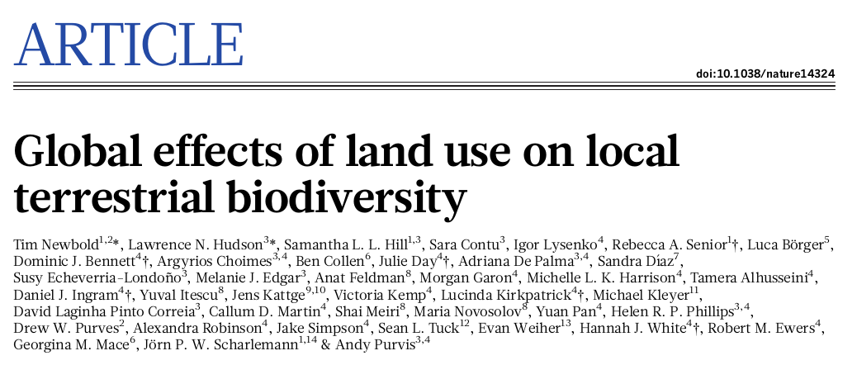

?
What are biodiversity models
Notes:
Prominent way are so called biodiversity models. Multiple in numbers

Slide 3
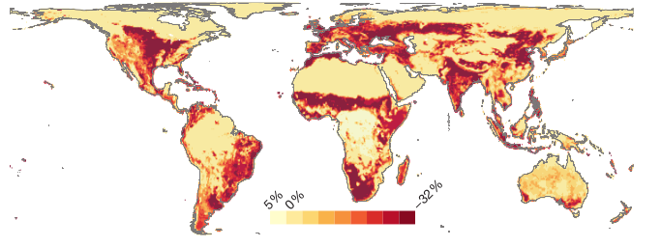
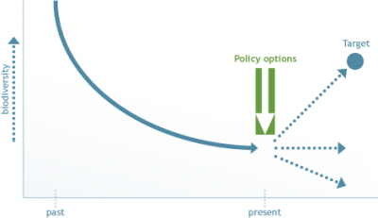
?
What can they be used for
- Response of biodiversity to anthropogenic pressures
- Global application, multiple species groups, spatial explicit
- Models for biodiversity policies
Netto loss of local biodiversity due to land use
Newbold et al. (2015)
Policy intervention possible?
http://globio.info

Slide 4
The Problem:
Many broad-scale models generalize over a wide range of variables
Often only single factor ( land use ) models
Based on available ( biased ? ) data
Notes:
- Necessary to find global application Such as classifying different land use categories into a single one
- Diversification of available data
- Collected data might be spatially-temporal biased

Slide 5

How well does a broad-scale model reflect species diversity and abundance on a local land-use gradient where local conditions are known?
Notes:
Out of these problems I started to ask myself in this thesis...

Slide 6
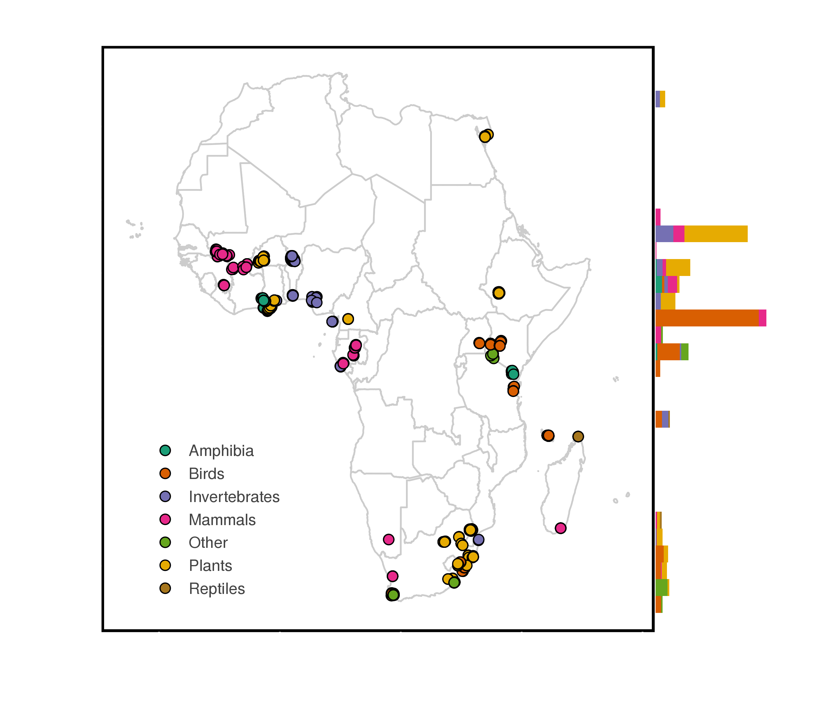
Notes:
Searched for literature
Shows all available sites at the time I finished the search

Slide 7
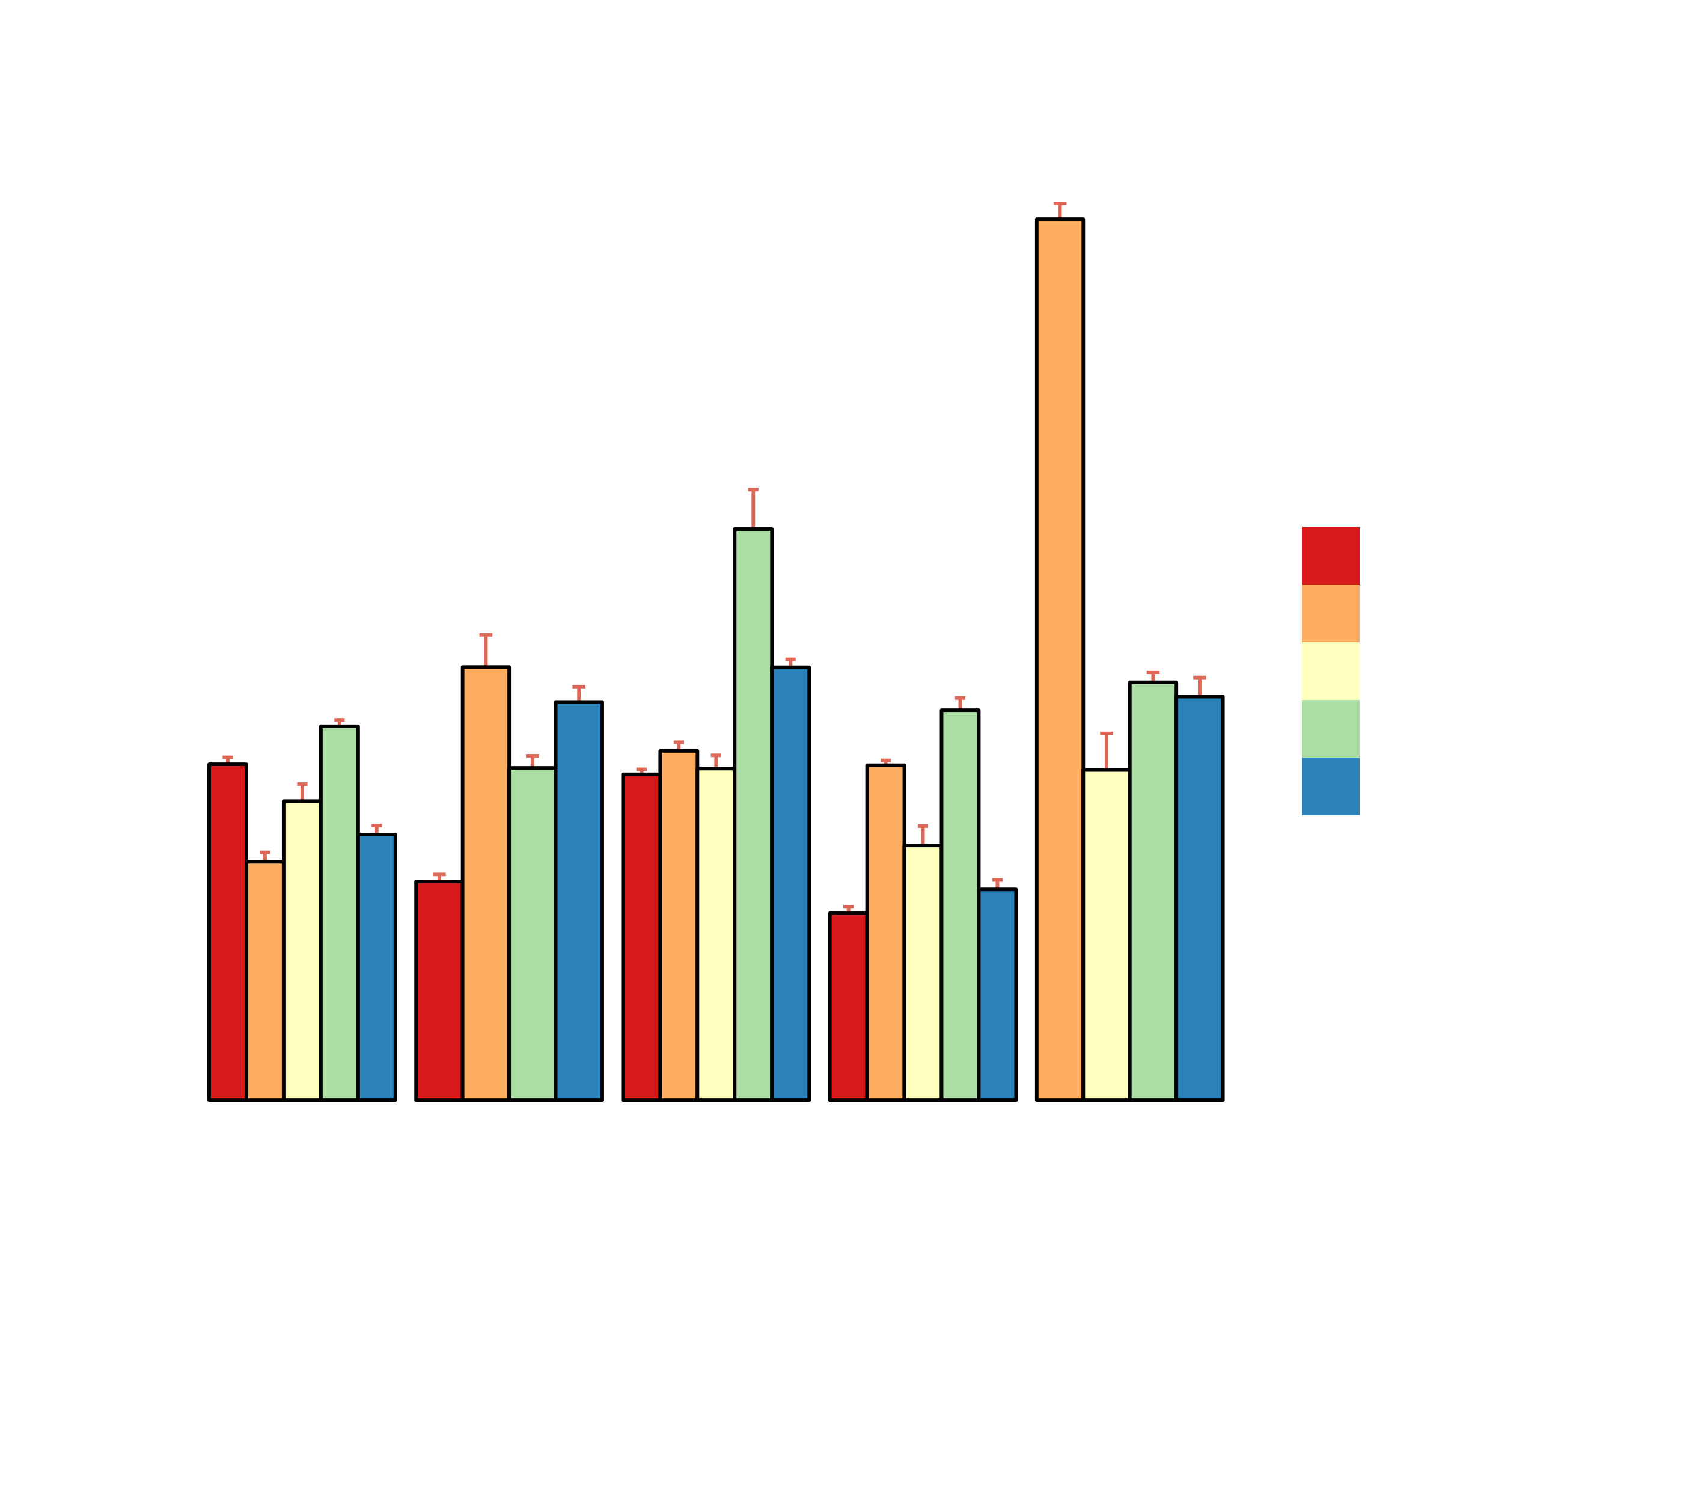
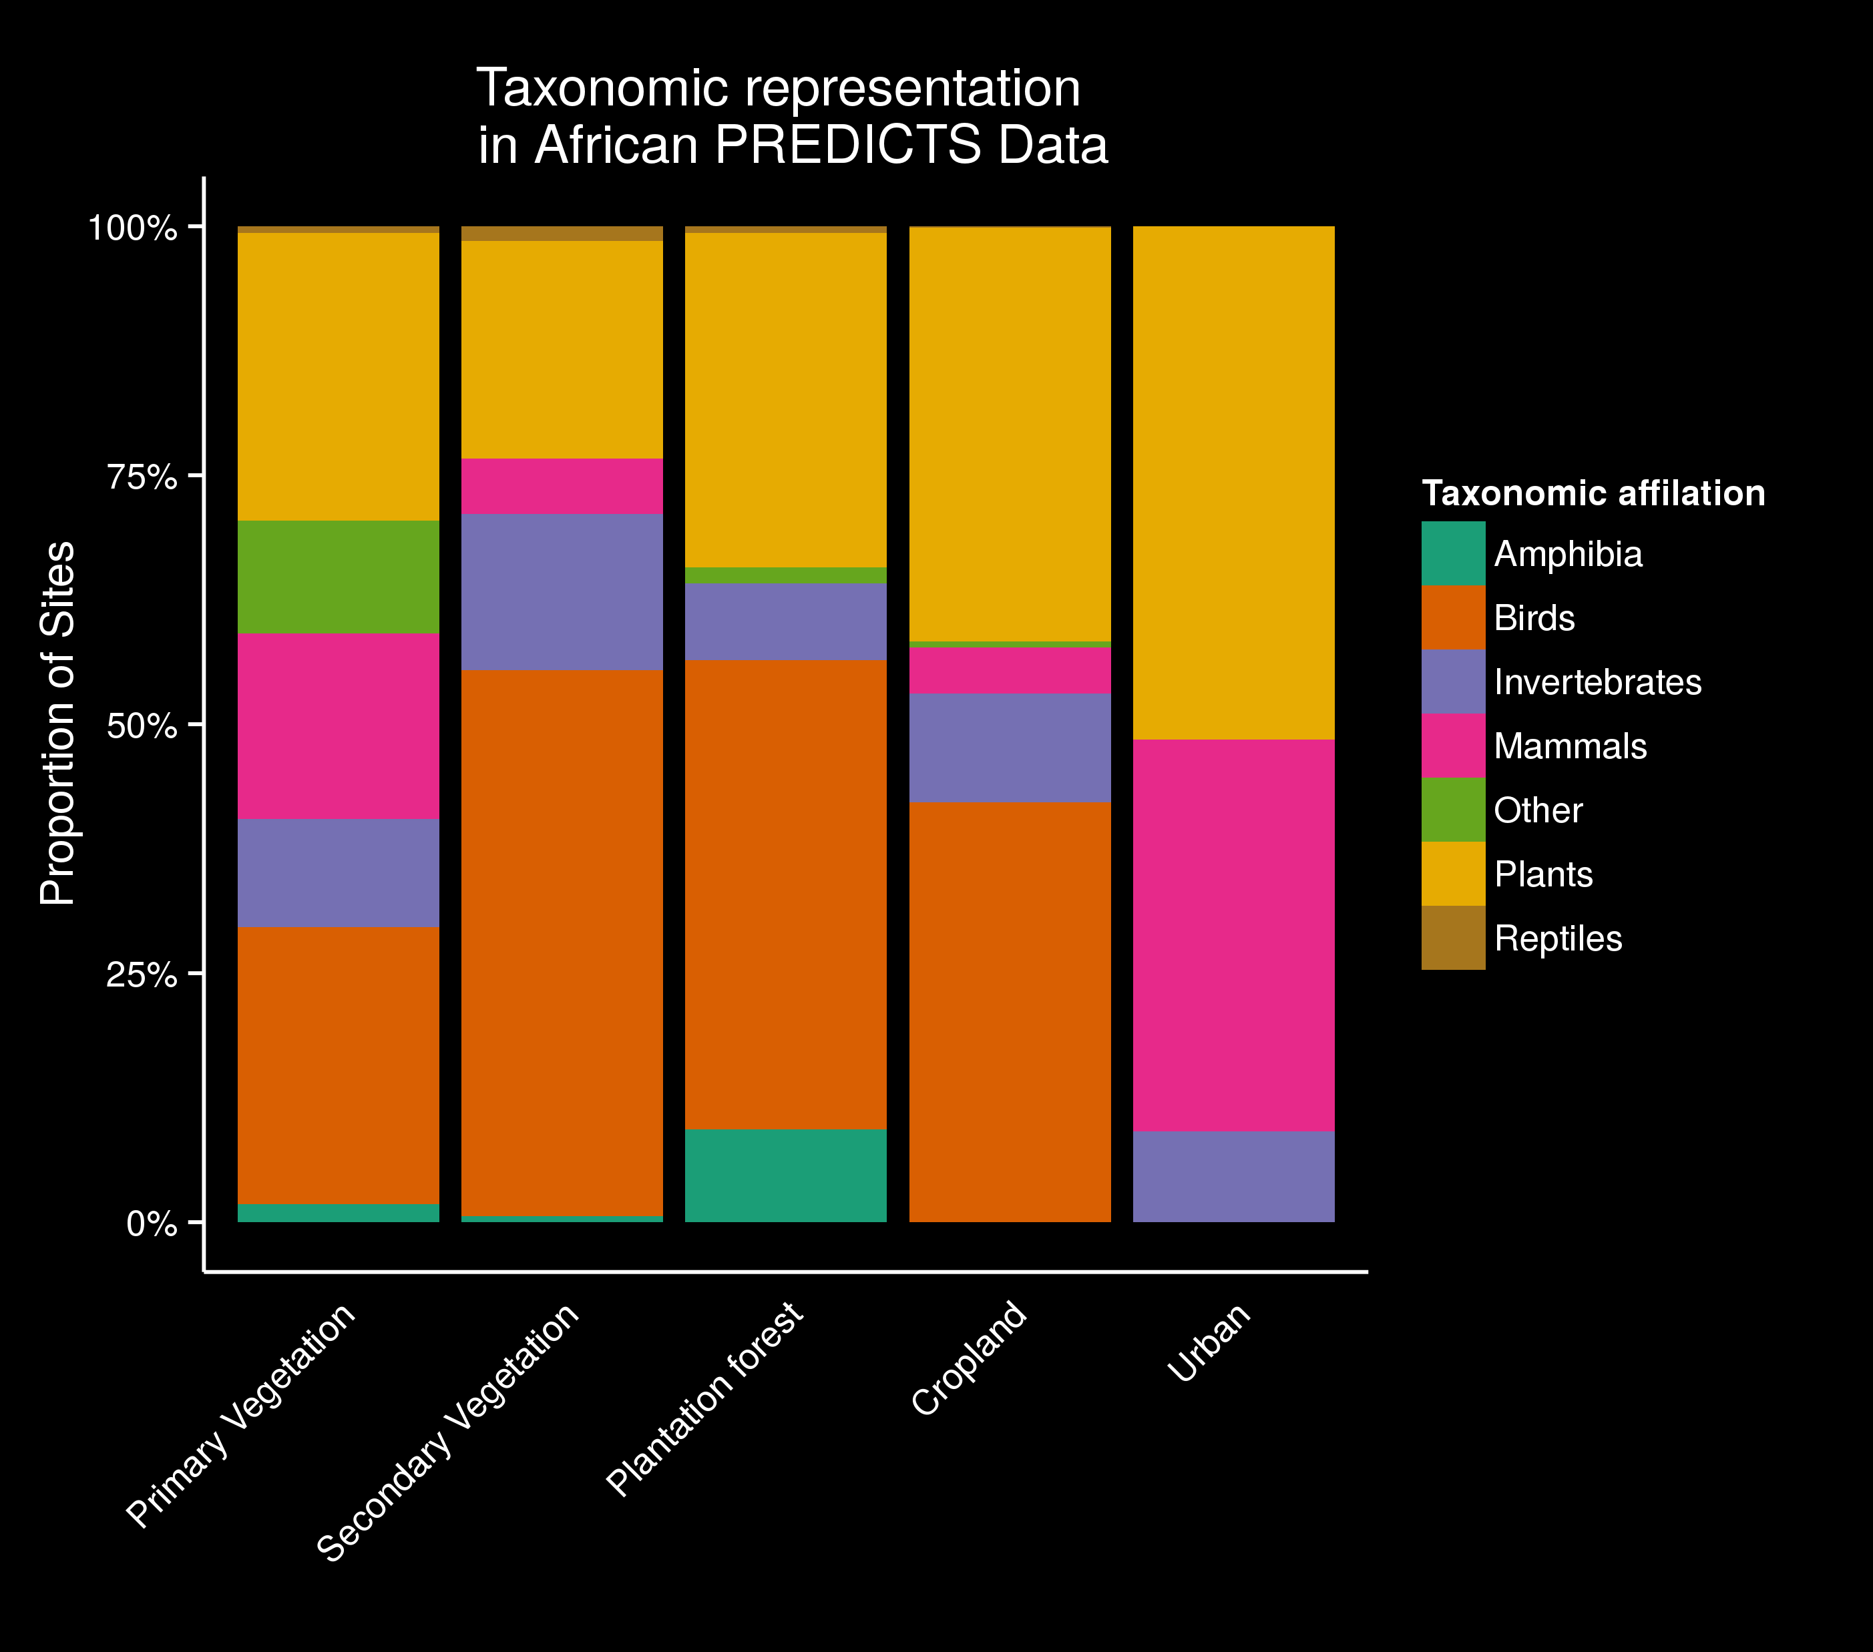
The broad-scale model basis
→ Final dataset contained 48 studies, 3002 sites and 1933 different species.
Notes:
Describe Model input
- log abundance sort of equal
- taxonimic represation mixed – all facets of diversity limited to more natural habitats

Slide 8
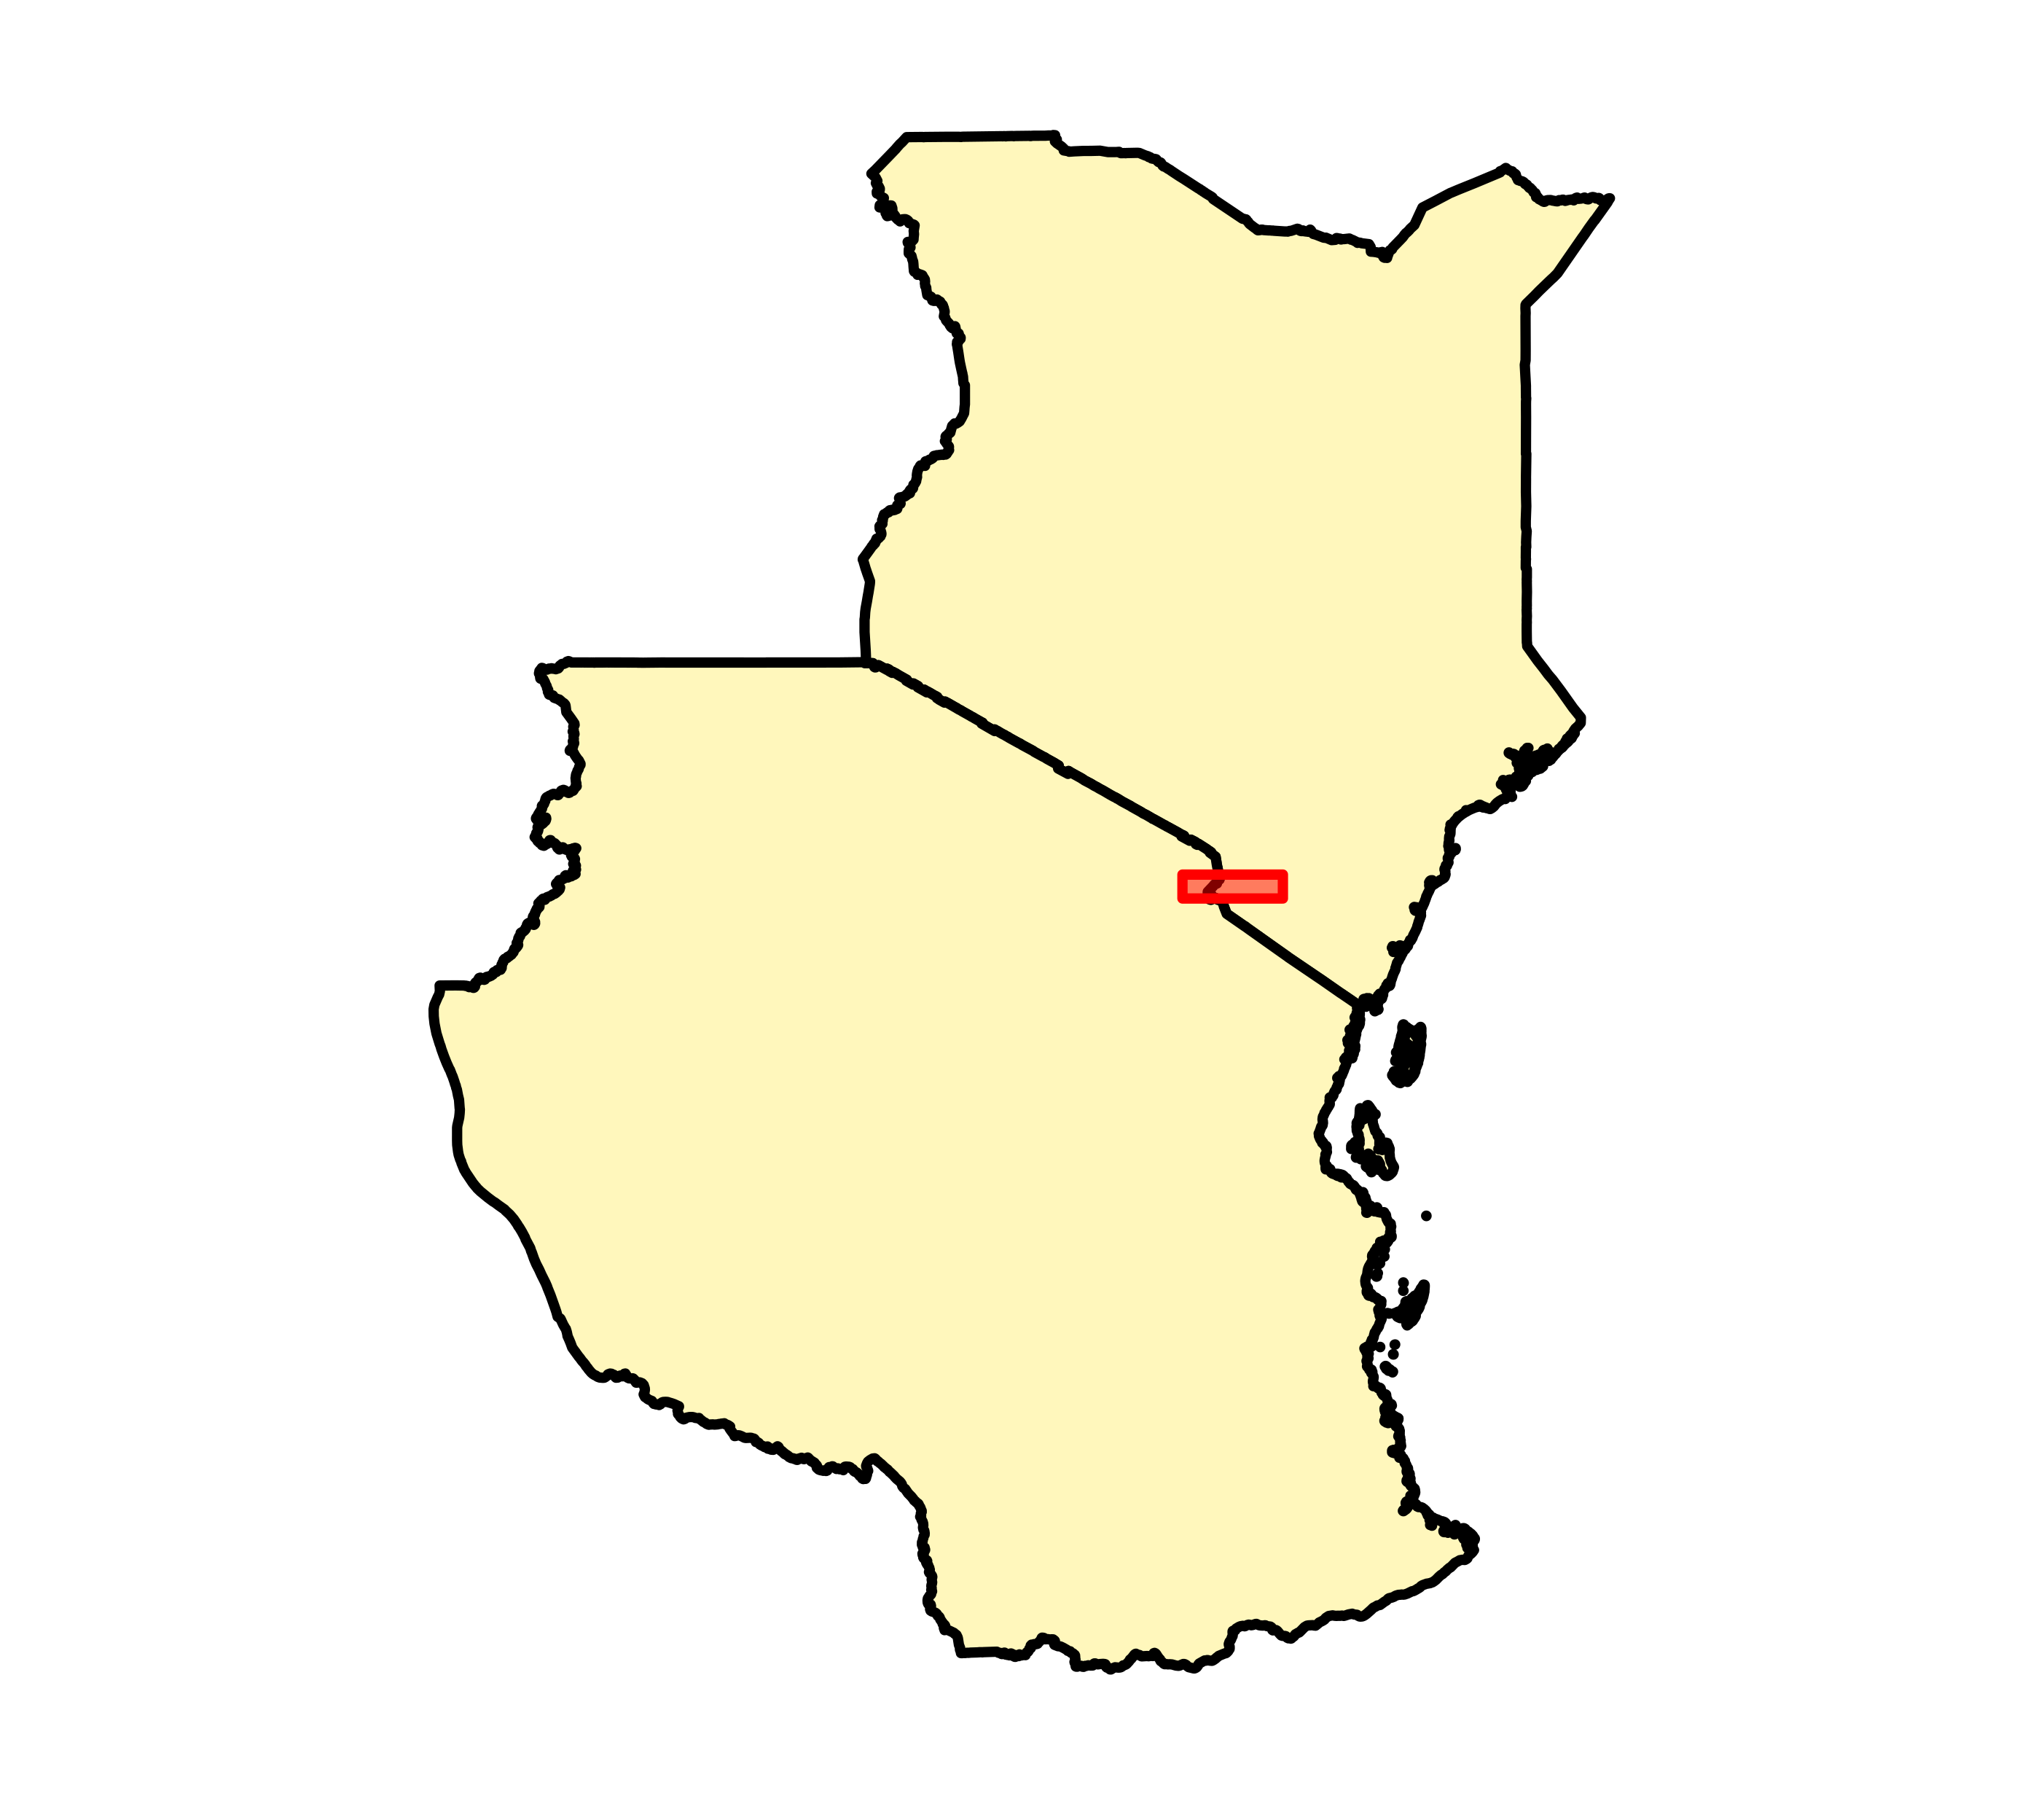
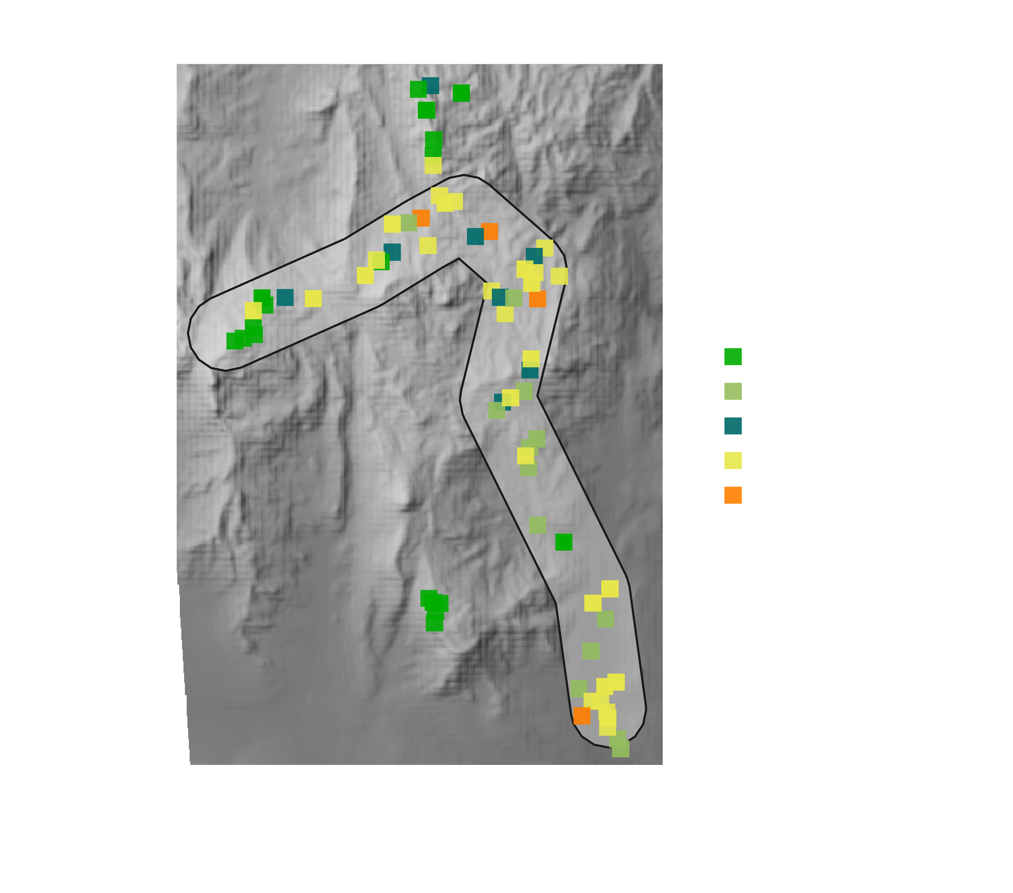
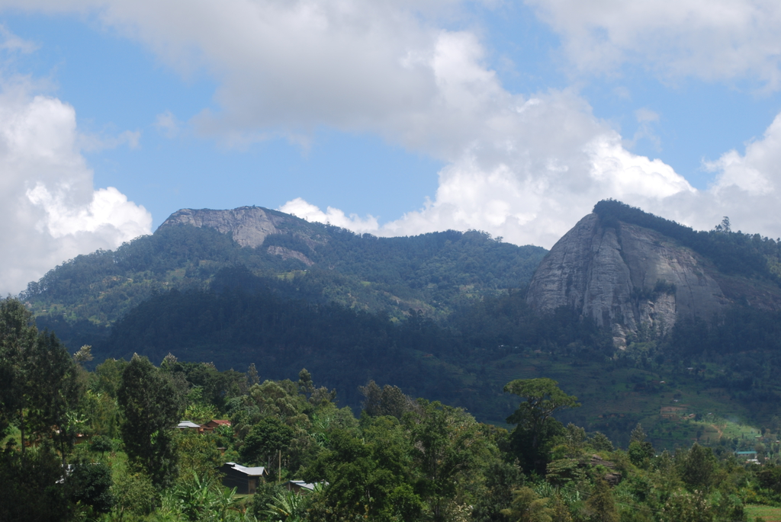
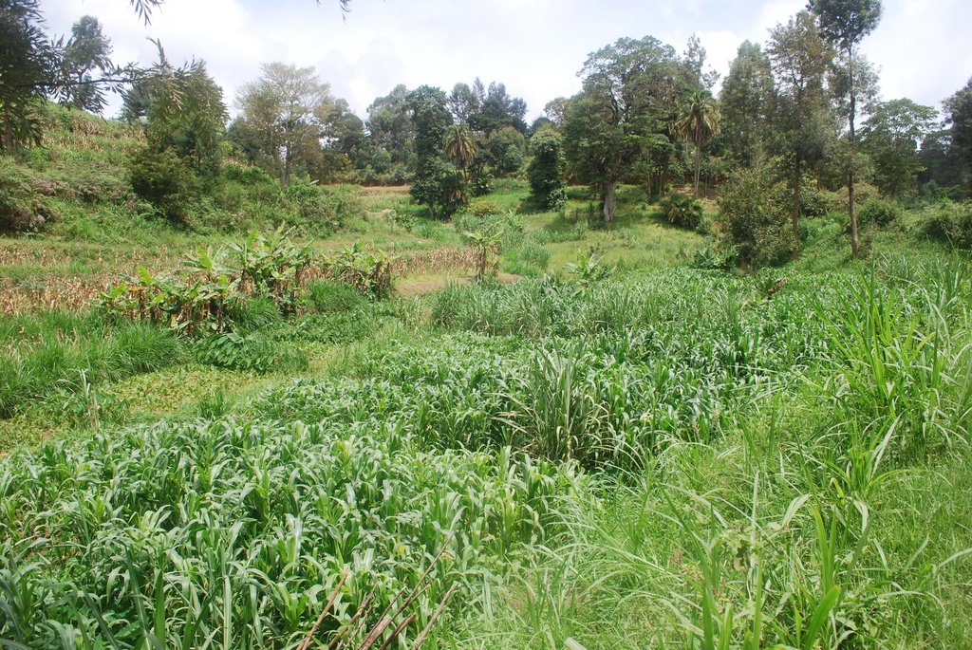
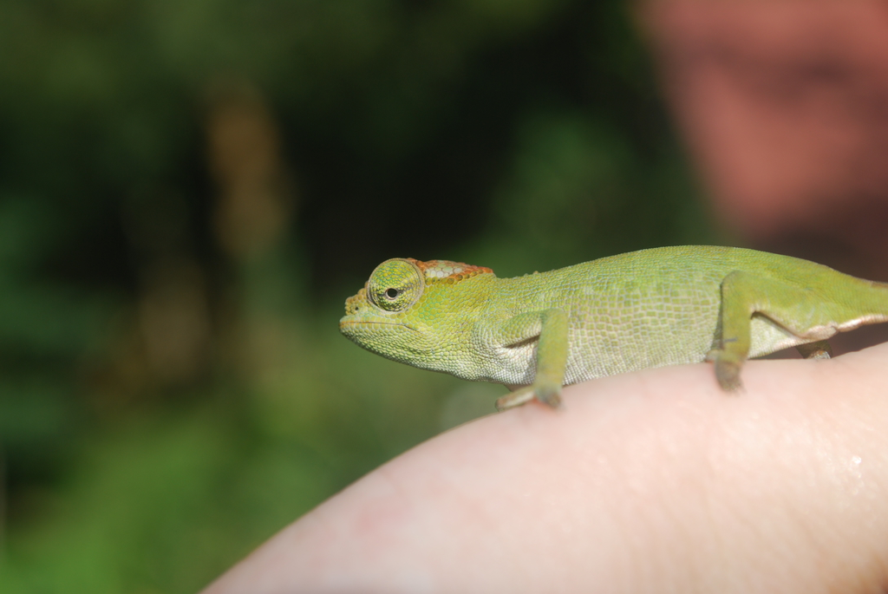
Fieldwork sites
– Taita Hills
Notes:
- Northern tip of the eastern arc mountains.
- Biodiversity hotspot and densely populated
- experienced 90% forest loss during the last 200 years leaving remaining area small and fragm.
- intensively cultivated; small-scale farm-
Land, 200.000 people
- Since 1950 reforesting with exotic plantation trees

Slide 9
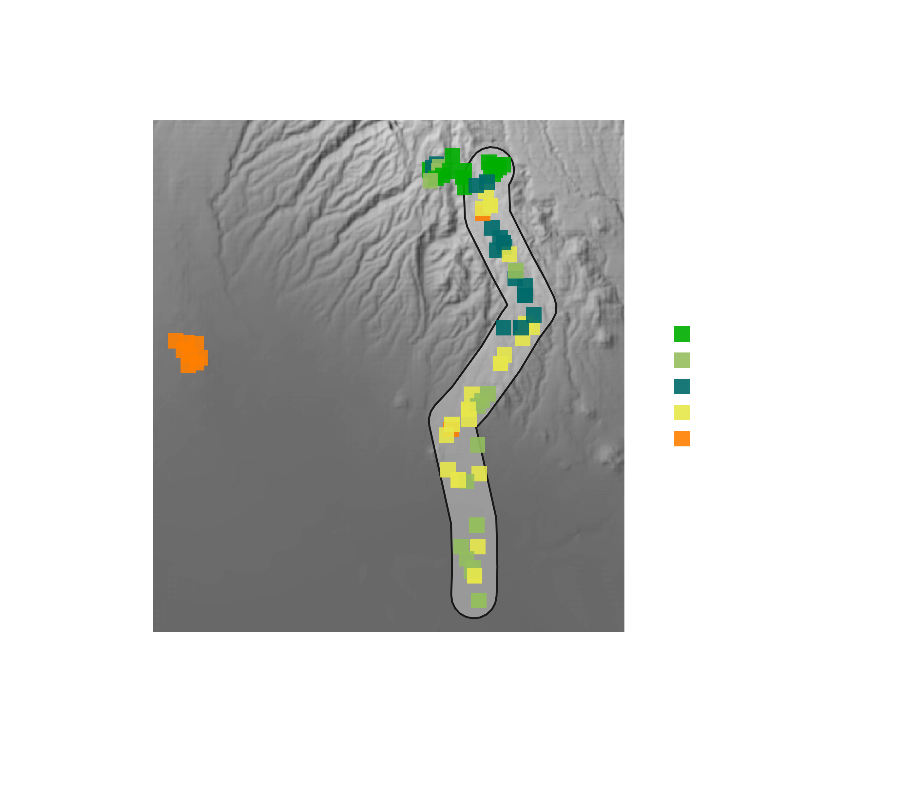
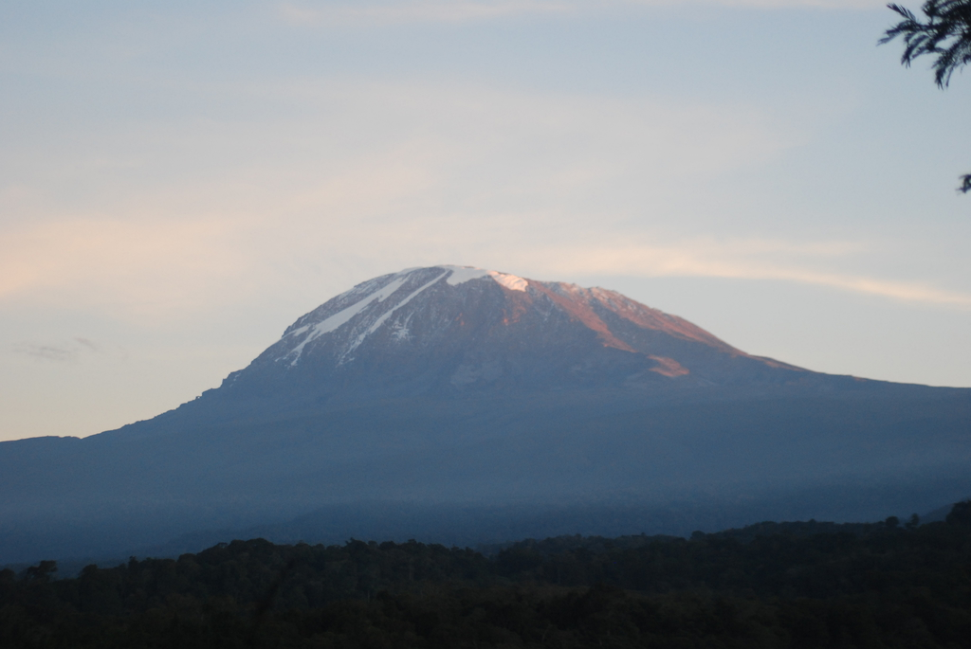
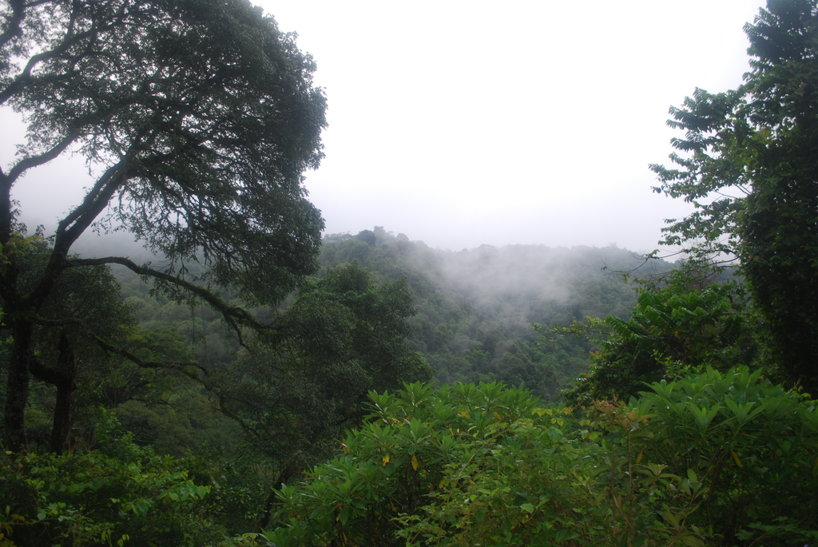
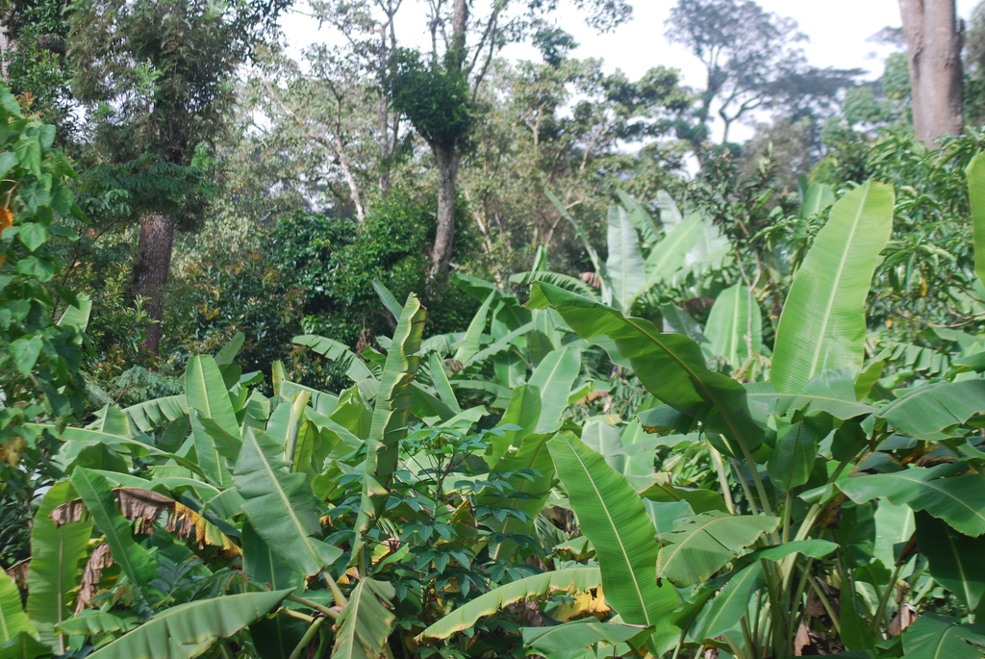
Fieldwork sites
– Mount Kilimanjaro
Notes:
- relic of an ancient volcano 5895m high
- Chagga homegarden maximizes use of limited space
- long history of usage. Richness high, but Endemism low in primary vegetation
- 1895 - 60.000 > 2002 – over 1.mill multiplied 20x

Slide 10

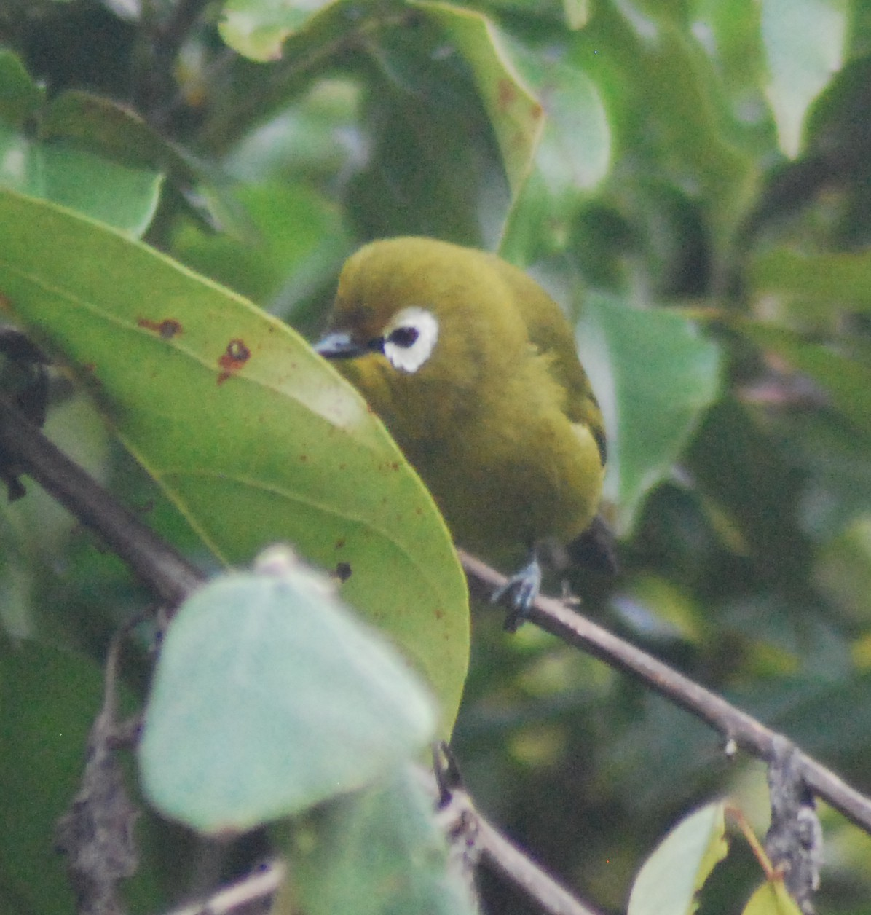
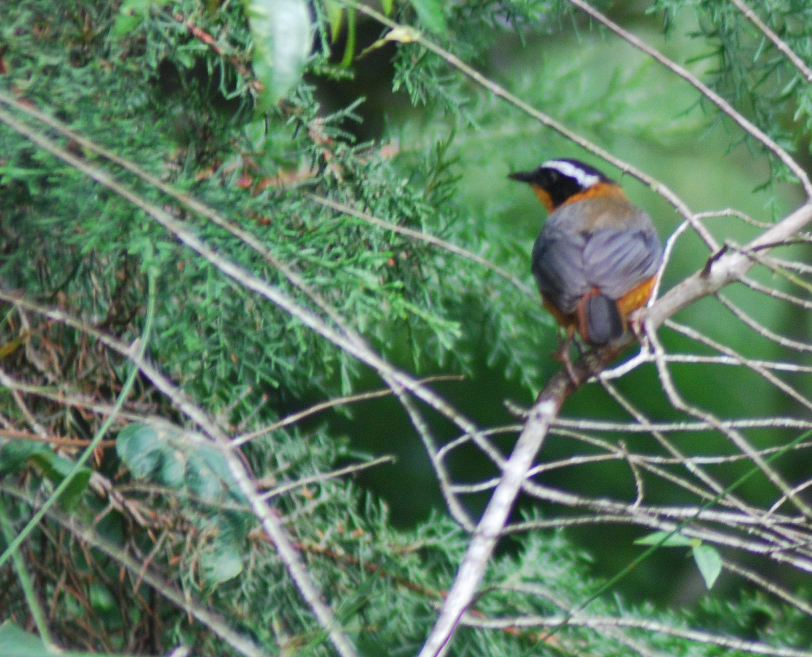
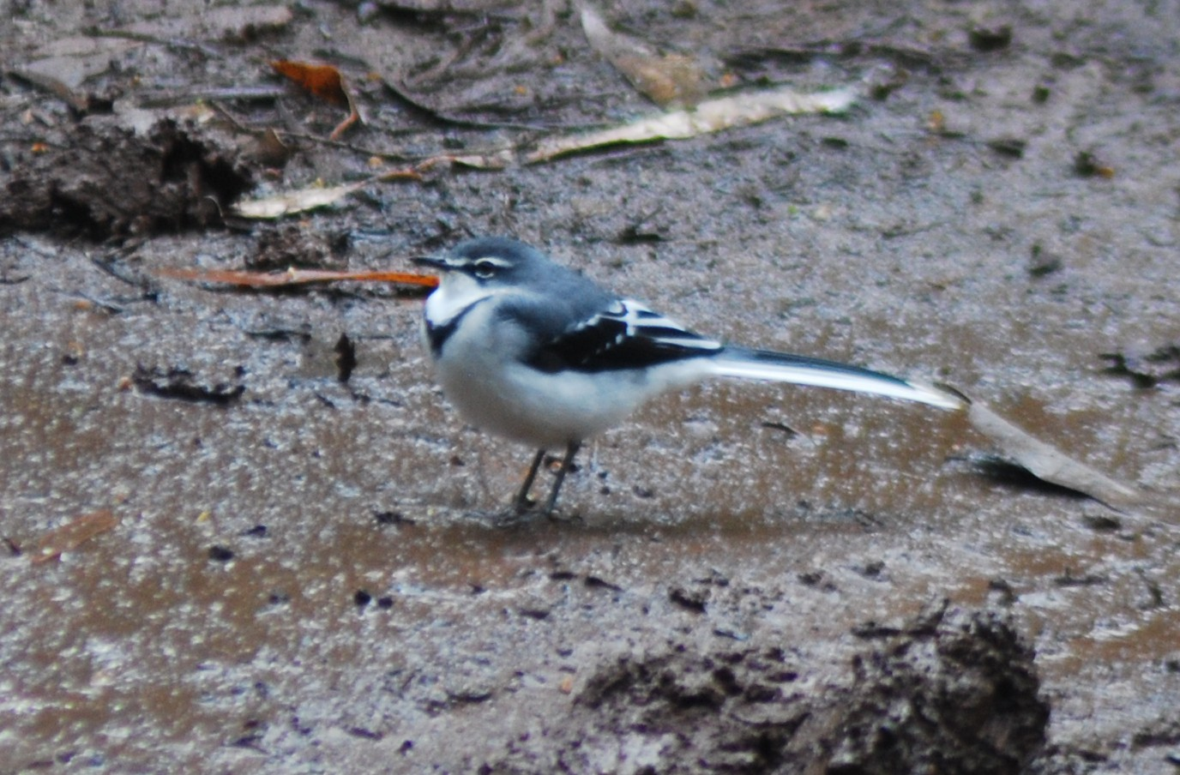
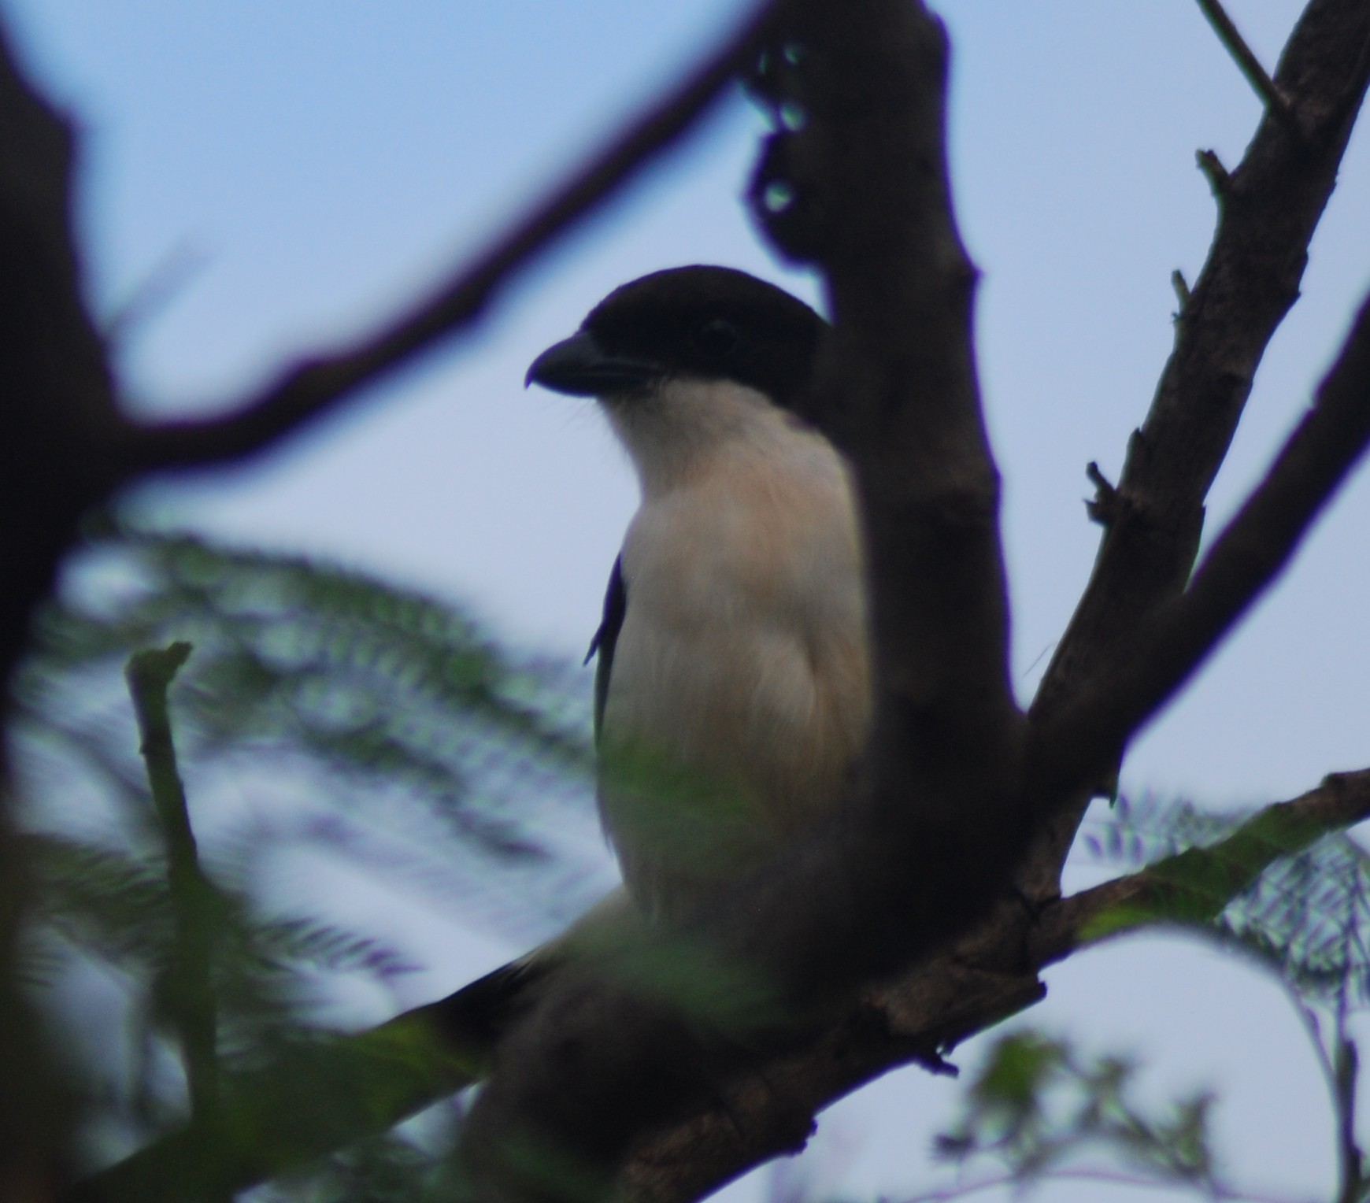
Timed point counts of Birds
Sites selected on representative land-use classes
Timed point counts in a 50m radius between March – May 2014
Two replicates for each site
Total 147 sites: 172 species, 2700 individual counts
Notes:
Note that is was breeding season
All land-use types with exception of urban show satisfying sampling intensity on species accumulation curves
Total roughly represents 5 % of sites in predicts and 9% of species
Speckled Mousebird, Montanious whiteeye, white-browed robin-chat, Montane Wagtail, Common Fiscal

Slide 11
Auxiliary data
Remote-sensing data
Vegetation dynamic during Sampling (yield EVI) (Source: MODIS Terra Sat.)
Population density (people/100m²)
(Source: AfriPop)
Forest cover in the year 2000 (Source: Hansen et al. 2013)
Functional traits
Community-weighted average range size (1° cells) (Source: GBIF)
Proportion of threatened species
(Source: IUCN)
Forest specialization (Source: IUCN)

Slide 12
The results

Slide 13
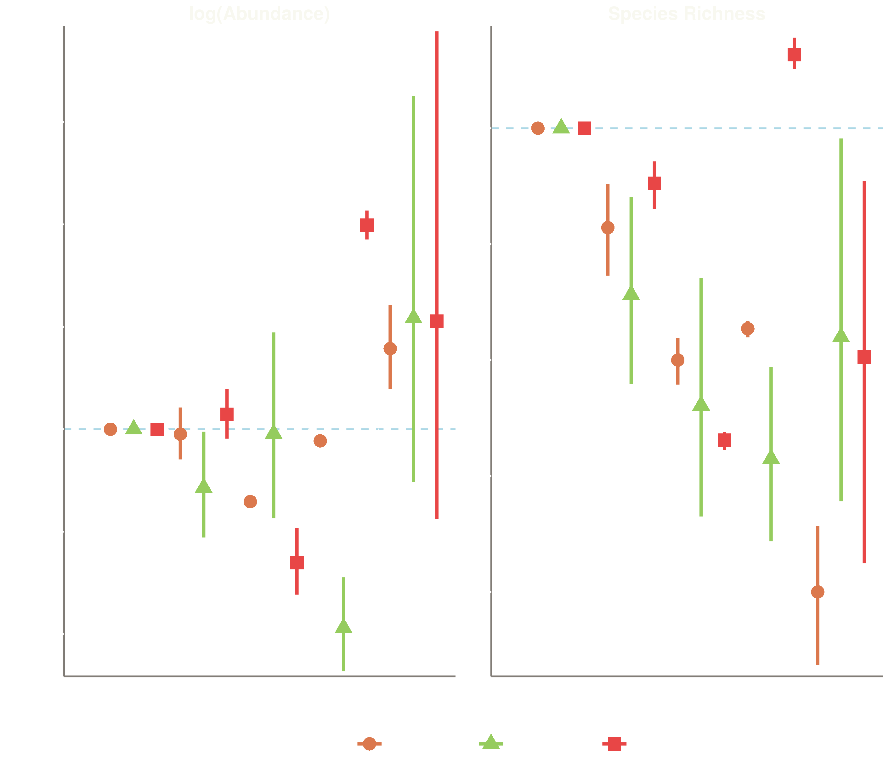

Slide 14
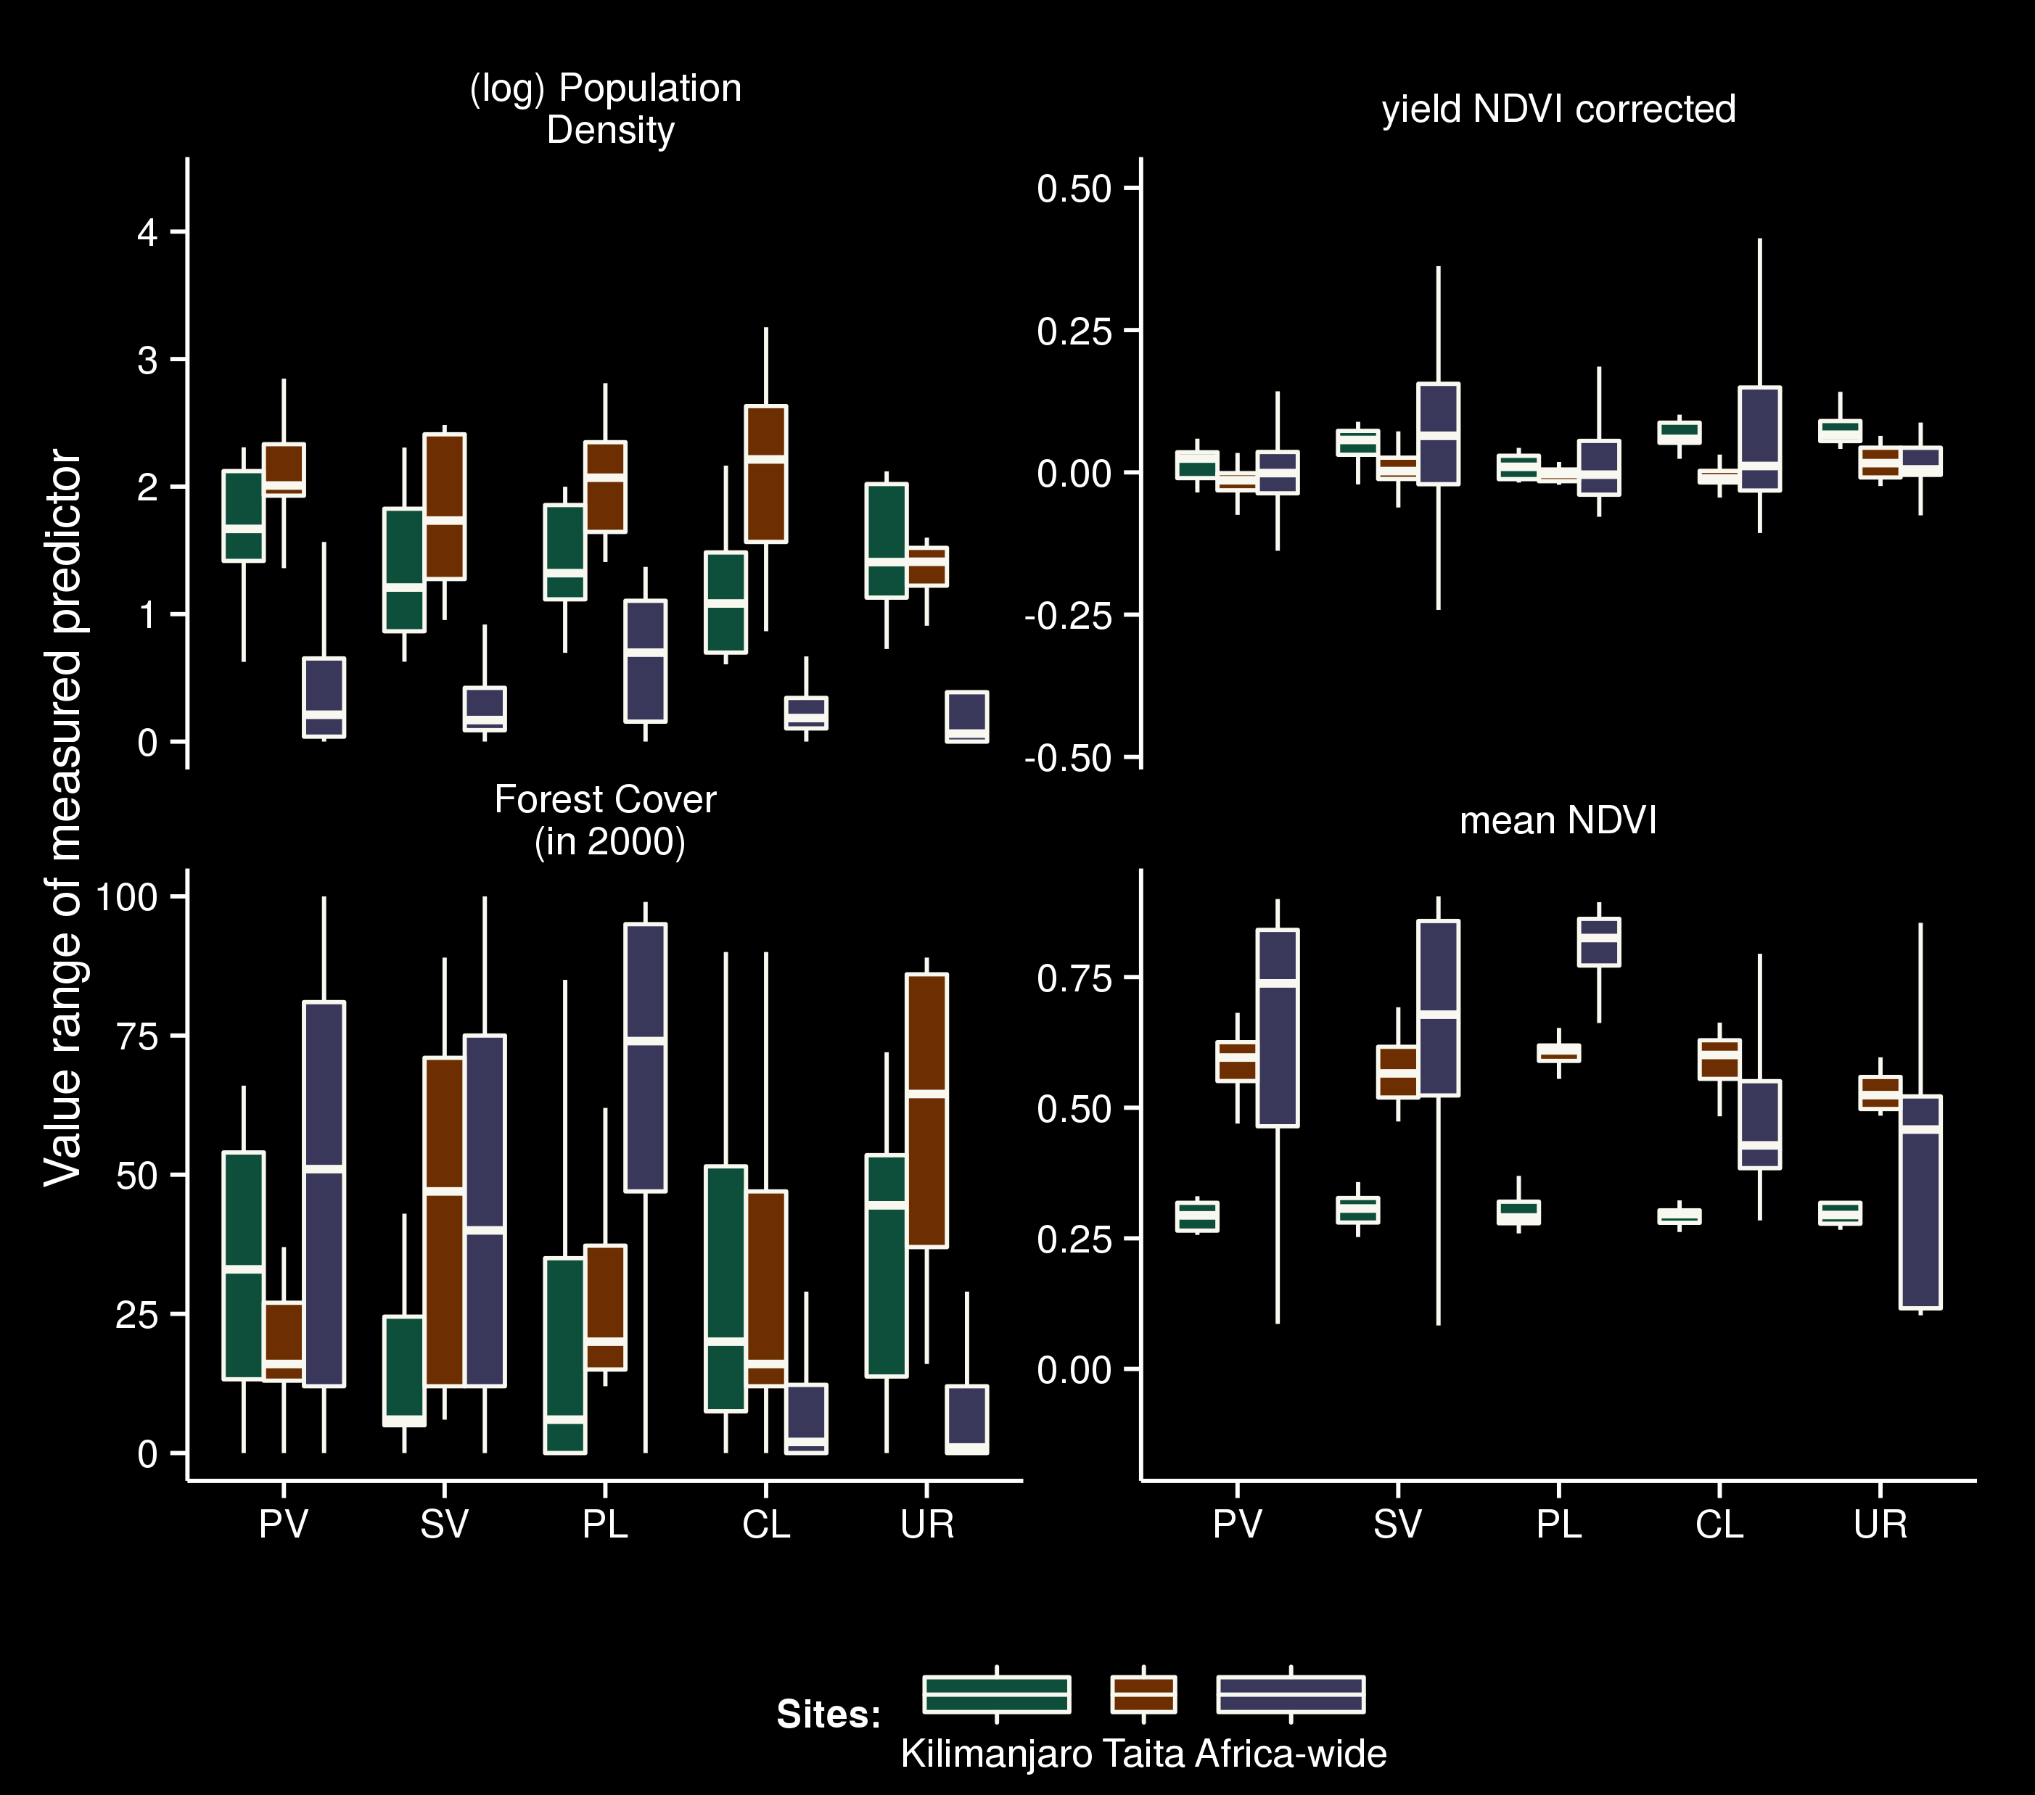

Slide 15
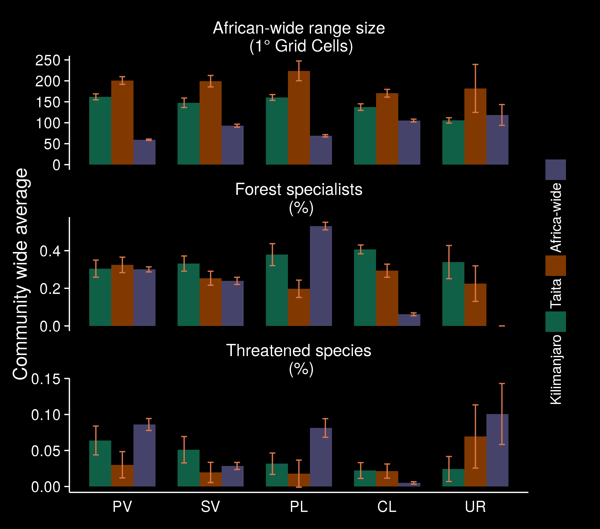
Notes:
Land use history might have influenced species richness by leaving species assemblages impoverished and relatively insensitive
to land-use disturbance

Slide 16
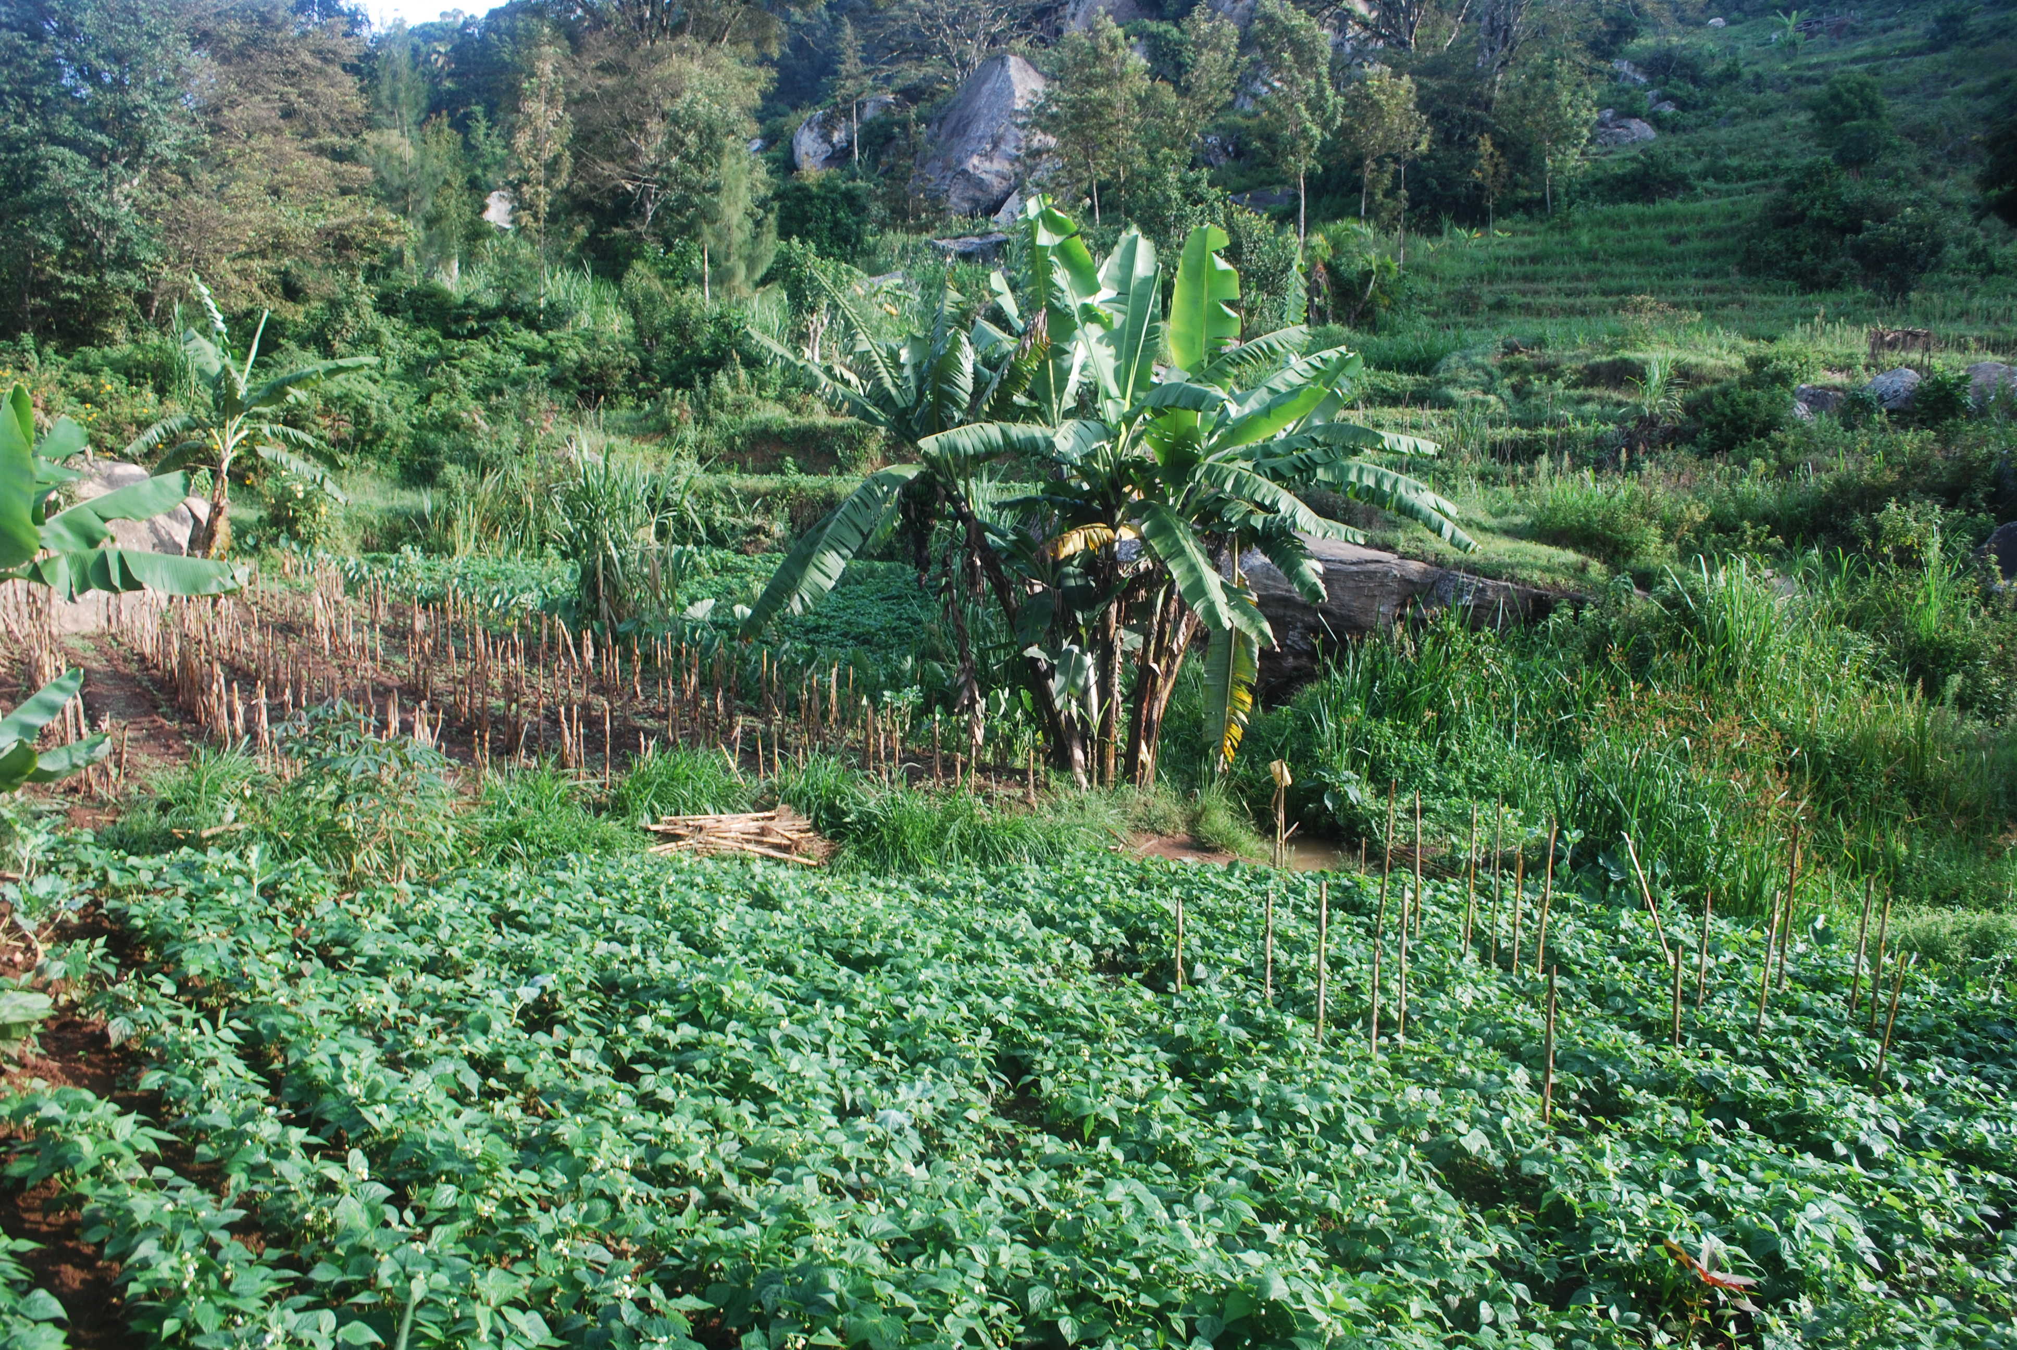
In summary:
Cropland higher number of species than the average more intense cropland site (Agroforestry)
More forest-specialists in cropland
Primary forest likely lower diversity due to size and fragmentation
Uncertainty in urban habitats
Homegarden in Taita Hills
Notes:
Plantation Forest. Reforestations and Fruit-Plantations used by Birds
Confirms assumption my Alkemade – Globio3
Agroforestry has higher mean species abundance 0.5 compared to cropland 0.3
Cropland with perennials
Management practices, such as theextent to which native trees are retained, probably affect biodiver-
sity more than the crop per se (Holbech, 2009)
Typical of the agrisilvicultural system of the Chagga ho-
megardens is their multilayered vegetation structure similar to a tropical
montane forest.

Slide 17
Conclusions

Slide 18
Large-scale models succeed at detecting overall impacts of land use change
However they might lose accuracy if they are used to predict local impacts on biodiversity, if local conditions do not conform
Policy makers need to look not only at large-scale patterns, but also at local differences, when deciding on conservation actions.

Slide 19
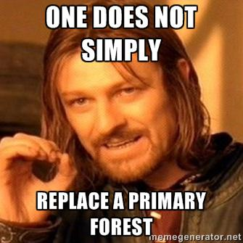

Thanks for listening
Acknowledgements
Tim Newbold and Neil Burgess for scientific advice
PREDICTS contributors for making data available (http://predicts.org.uk)
The CHIESA project partners for support and coordination
Everyone at CMEC and UNEP-WCMC for the great time
Danida Fellowship Centre for financial support

